Slide 1
Interactive Propositional Logic Engine using Natural Deduction
Utkan Gezer

Slide 2
Input Specification
True: T, TRUE
False: F, FALSE
Atom: r”^[a-z][0-9]*$”
Negation: !
And: &, *
Or: |, +
Implication: ->
Sequent: =>

Slide 3
Notes (Input Specification)
Premises of a sequent are to be separated with commas.
It is OK to leave out premises and the sequent mark (=>) if there are no premises.
Conclusion is obligatory: False can be given as the conclusion for deriving without a destination.
Implication is right-associative, as per textbook.

Slide 4
Natural Deduction Rules (&, |)
andi: #
ande1: #
ande2: #
ori1: #, formula
ori2: #, formula
ore: #, #-#, #-#

Slide 5
Natural Deduction Rules (->, !, F, !!)
impi: #-#
impe: #, #
negi: #-#
nege: #, #
bote: #, formula
negnegi: #
negnege: #

Slide 6
Natural Deduction Rules (etc.)
MT: #, #
PBC: #-#
LEM: formula
assume: formula (Opens an assumption box)
conclude: [nothing] (Closes an assumption box)
undo: [nothing] (Deletes a step or reverts a closure)
copy: #

Slide 7
Notes (ND rules)
It is OK to use commas or spaces for separating arguments passed to a rule.
Forgetting to give a formula is handled as letting user to retry.
Forgetting number arguments or providing something unexpected for them, may result in an error currently.
Program checks and exits with success when user reaches the conclusion.

Slide 8
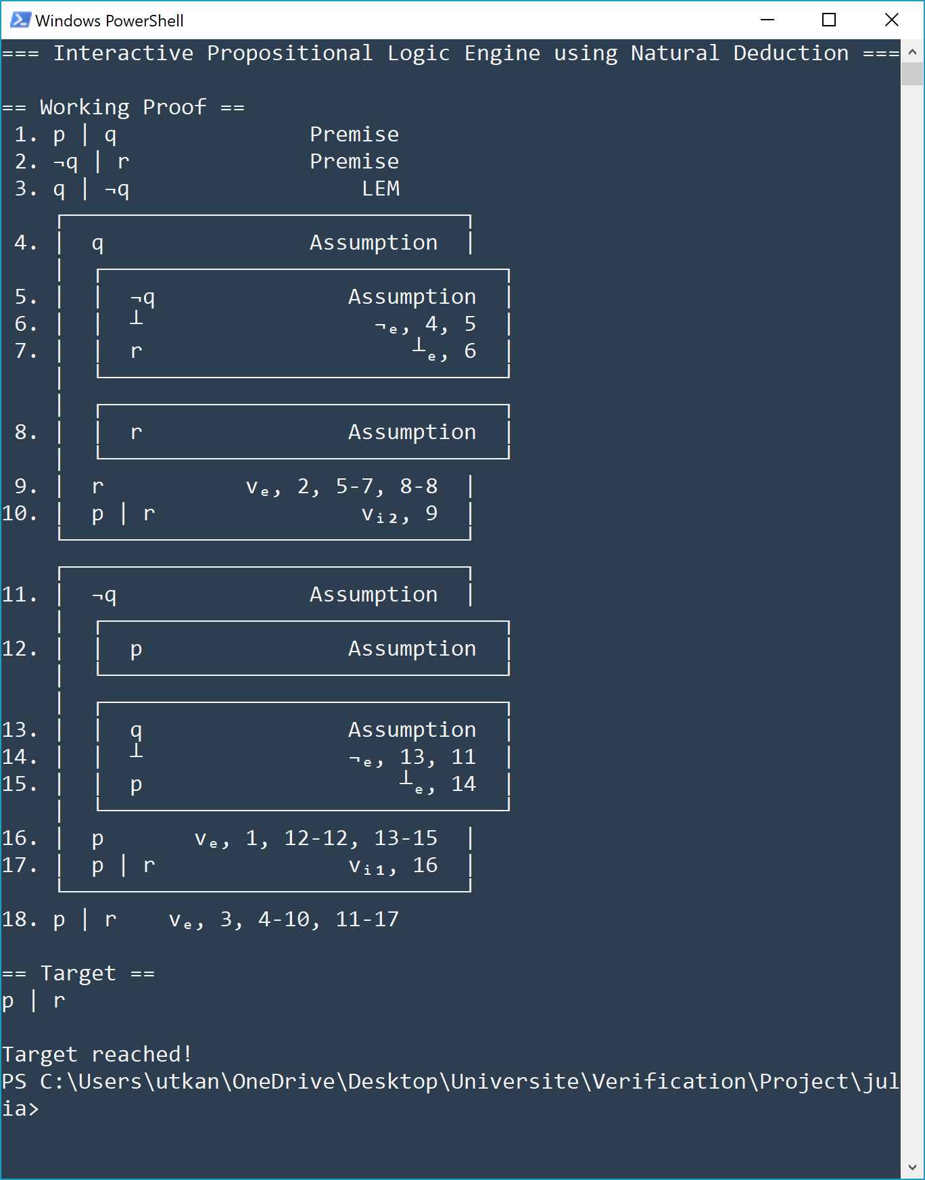
Example (p|q, !q|r => p|r)

Slide 9
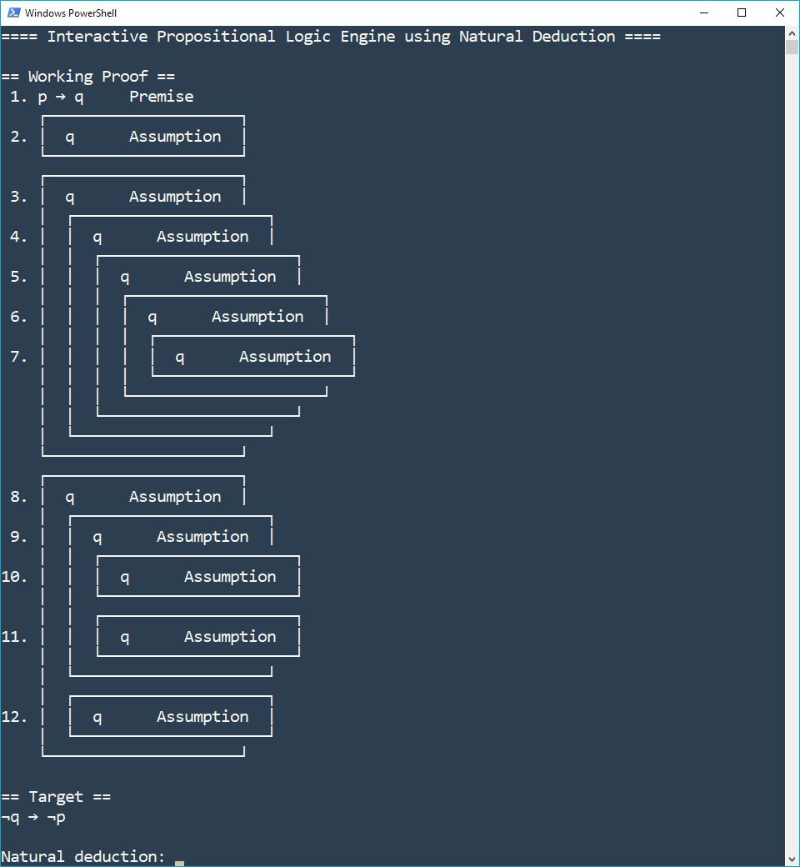
Failing Example (p->q => !q->!p)

